Slide 1
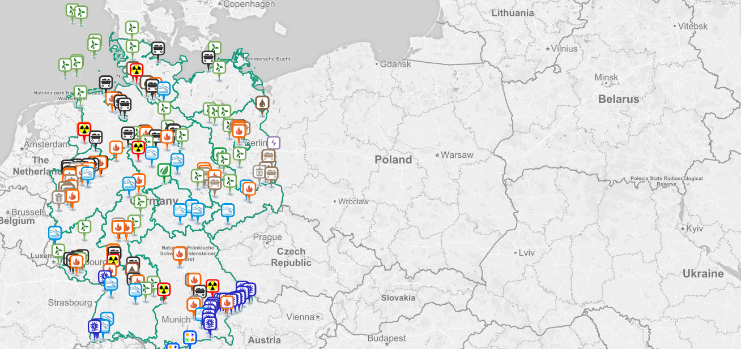
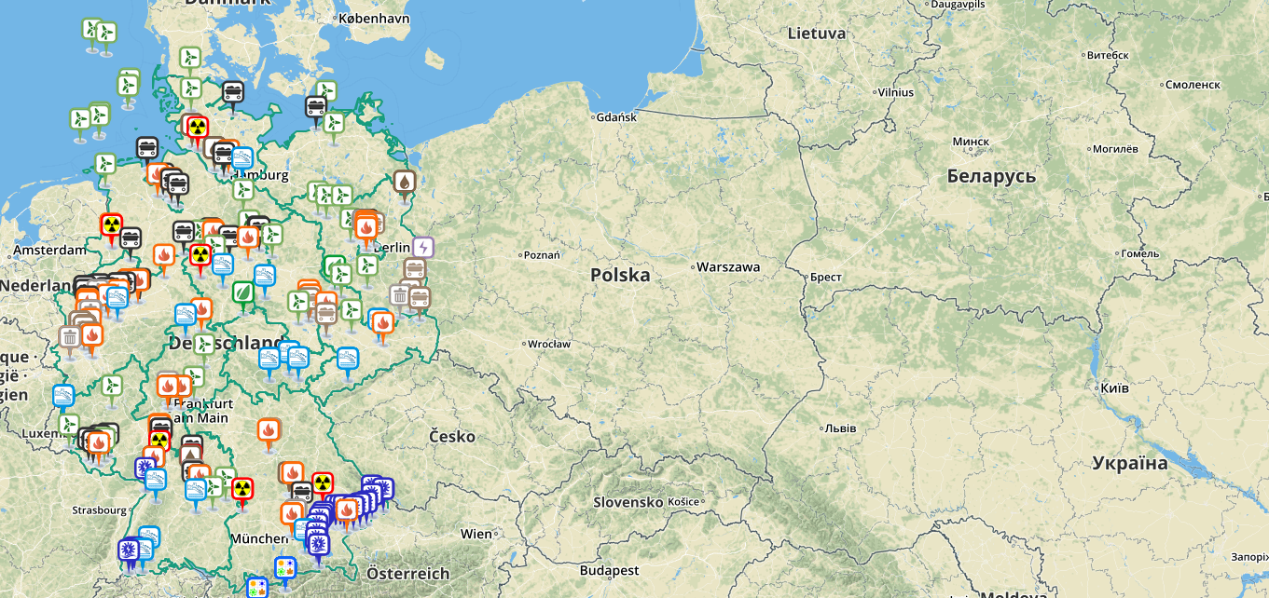

Welcome! to Master Thesis Project Presentation
Online Visualization of German Power Plants and Their Production
Universitätsstr. 38
23.03.2017
Kazi Riaz Ullah
INFOTECH

Slide 2

Online Visualization of German Power Plants and Their Production
Kazi Riaz Ullah
INFOTECH

Slide 3



Collaboration
This master thesis project is performed in cooperation with Visualization Research Center (VISUS) of University of Stuttgart and Fraunhofer Institute of Solar Energy Systems ISE.
Allmandring 19
70569 Stuttgart
Germany
Heidenhofstraße 2
79110 Freiburg
Germany

Slide 4


Collaboration
The project is performed in cooperation with
Visualization Research Center VISUS of University of Stuttgart
Fraunhofer Institute for Solar Energy Systems ISE of Freiburg.
STUTTGART
Freiburg

Slide 5






Under the supervision of
Prof. Dr. Daniel Weiskopf
VISUS University of Stuttgart
Prof. Dr.-Ing Bruno Burger
Fraunhofer ISE
Dipl.-Inf. Rudolf Netzel
VISUS University of Stuttgart
Dipl.-Inf. Alexander Schultz
Fraunhofer ISE
Dipl.-Inf. Nils Rodrigues
VISUS University of Stuttgart

Slide 6
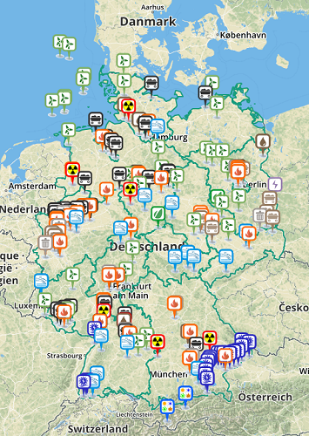
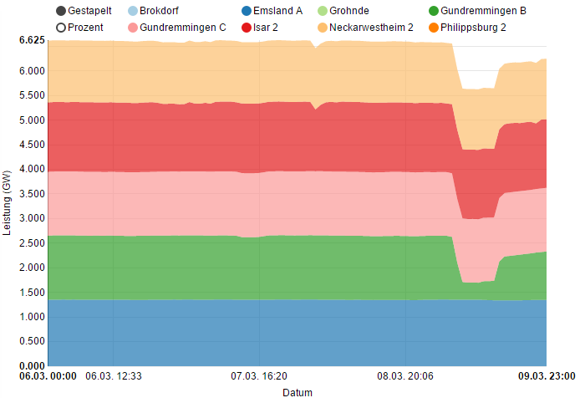
Project Title
Online Visualization
of
German Power Plants
and
Their Production

Slide 7
Outline
1
Background
Data Source
2
Tools
Libraries & Plugins
3
Architecture
Functionality
4
Online Survey
Evaluation Results
5
Conclusion
Q & A Session

Slide 8






Outline
Data
Data
Background
MAP
Data
Data
Tools
Survey Reports
Data
Data
Architecture
Demonstration
Conclusion and Q&A Session

Slide 9
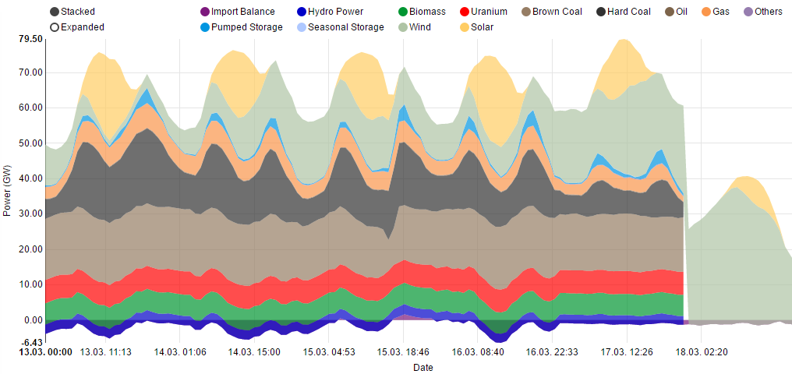
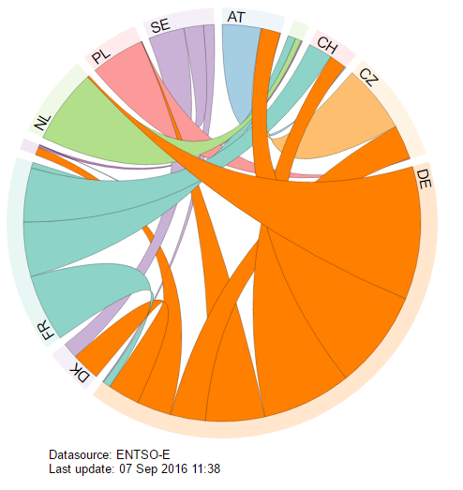
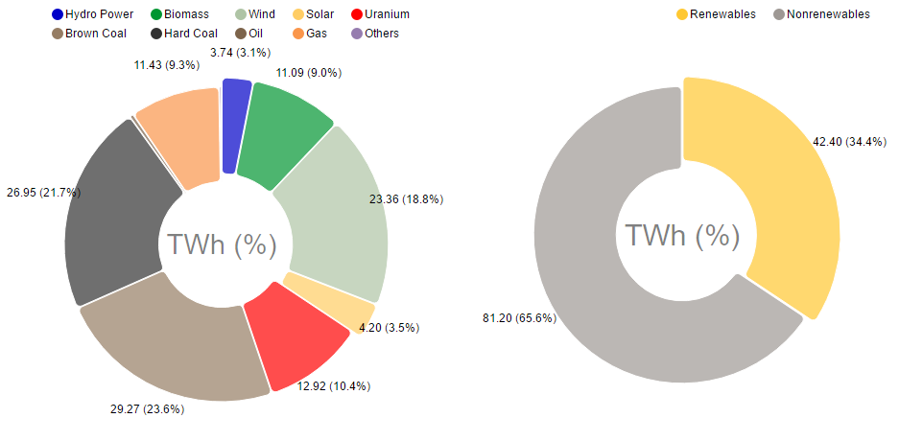
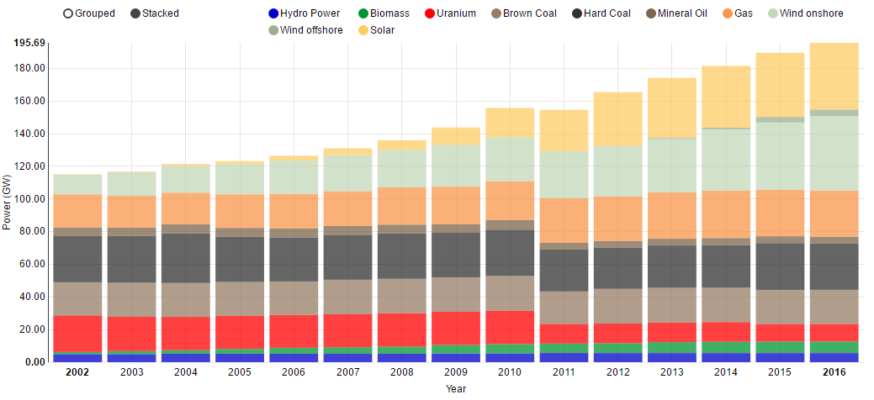
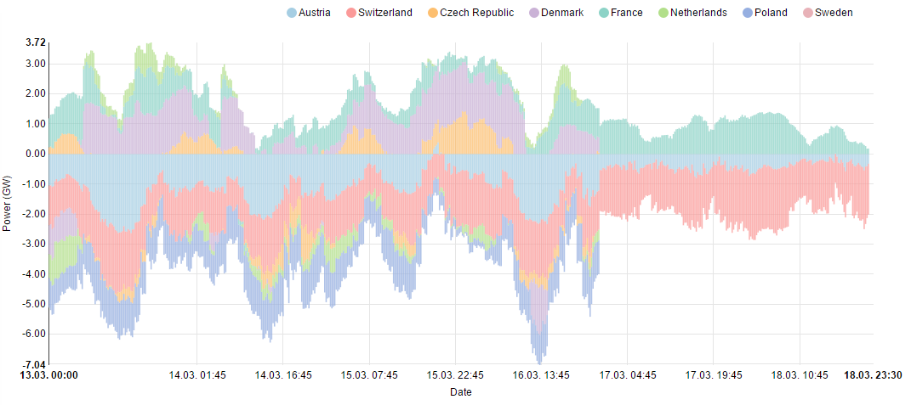
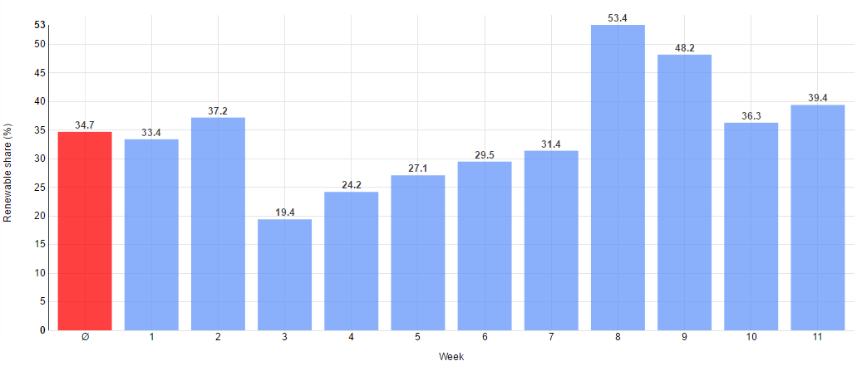
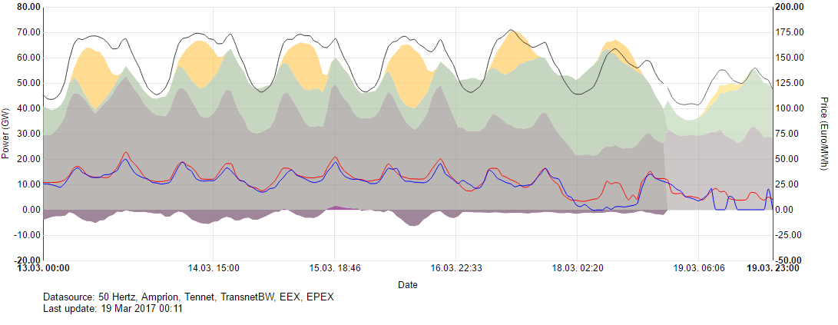
Background
Since July, 2014 , Fraunhofer ISE has been providing up-to-date data on German electricity production using interactive charts.
It was developed to deliver a solid database for the political discussion around the German energy transition to renewables, called “Energiewende”.
Available charts:
Electricity production of renewable & non-renewable power plants (Stacked area chart, pie charts)
Installed power in Germany (Bar chart)
Import and Export of electricity (Bar, Chord diagram)
Renewable shares of electricity production (Bar chart)
Spot market prices (Stacked area chart, line graph)
Notes:
The website was developed to deliver a solid database for the political discussion around the German energy transition to renewables, called “Energiewende”

Slide 10
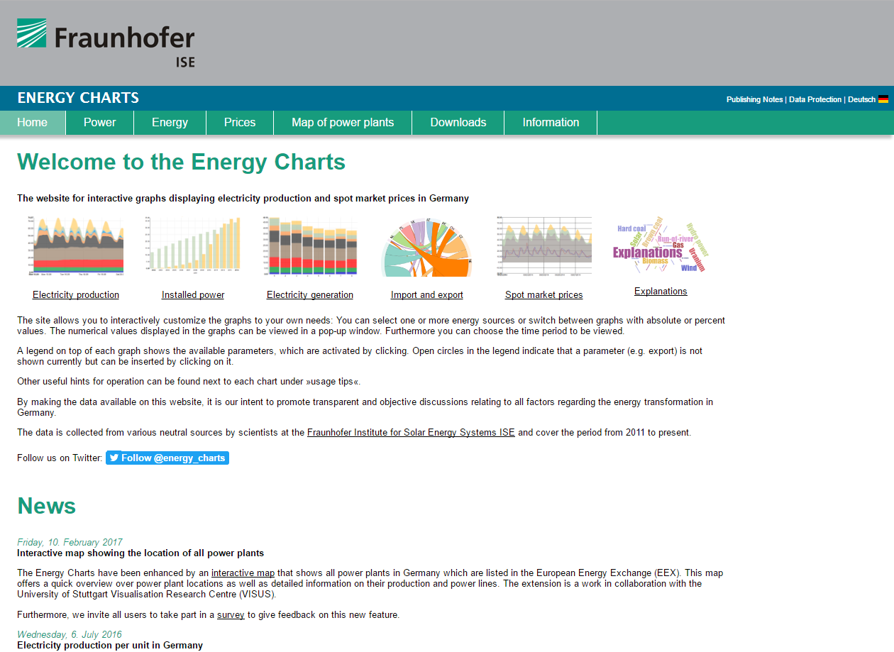
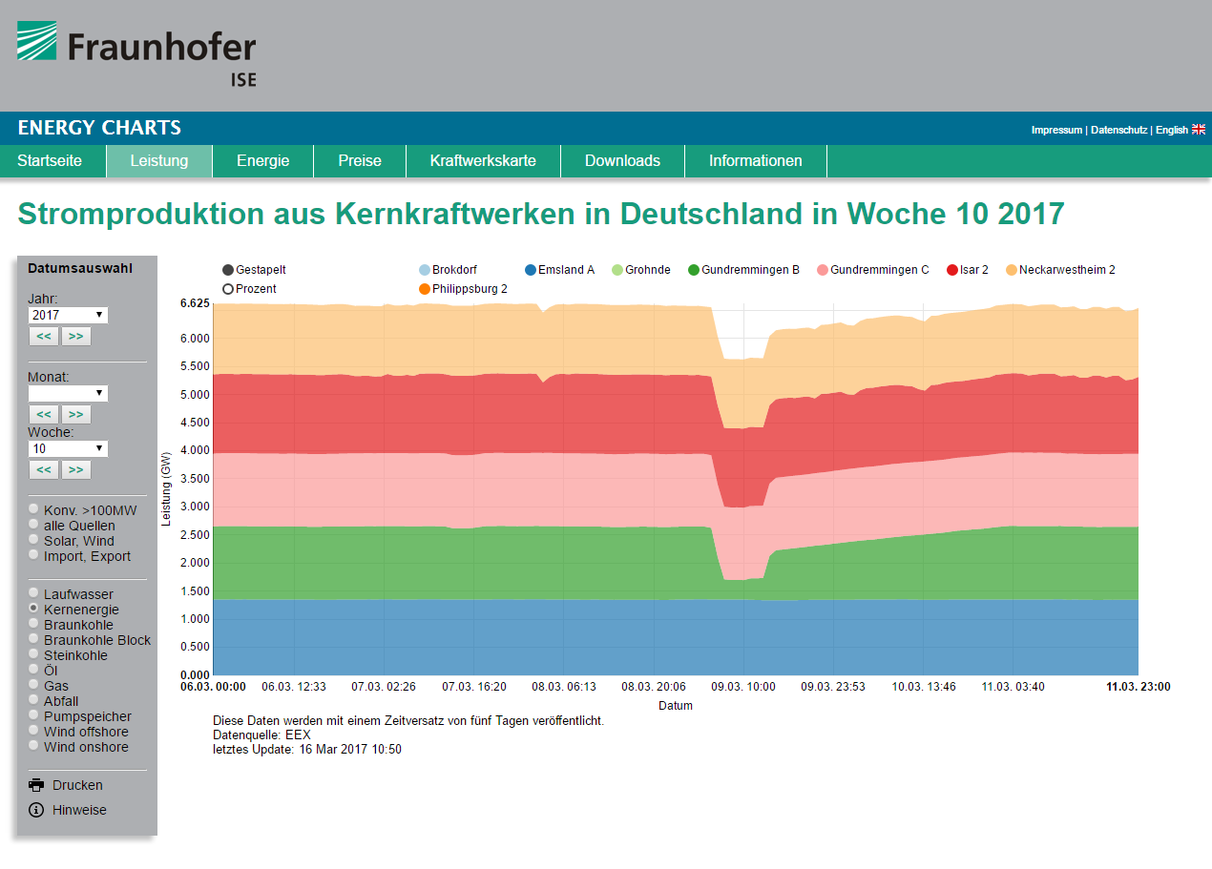
Background contd.
The comprehensive database is available on: www.energy-charts.de
Times series visualization of Electricity
production (Stacked area chart)
Home page of Energy Charts

Slide 11
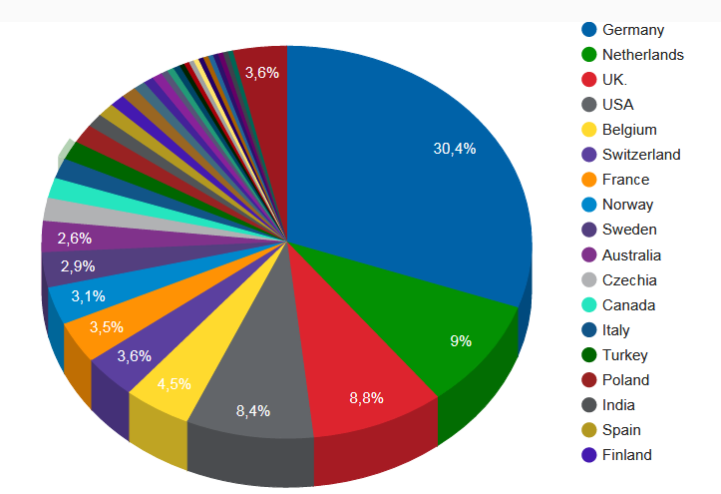
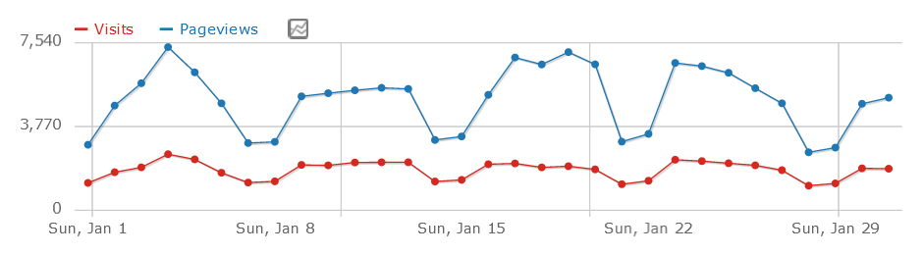
Background contd.
Since then, Energy Charts became very popular and widely used by scientists, politicians, engineers and journalists from all over the world.
Fig: Visitors of Energy Charts page in January (Piwik analysis)
Average visit per day 1243 times.
Fig: analysis of the follower of the
twitter account

Slide 12
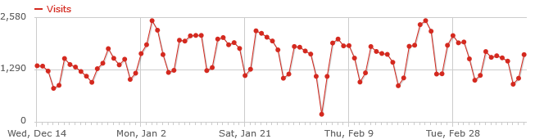
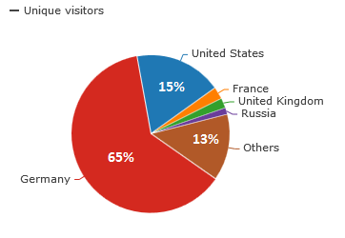
Background contd.
Since then, Energy Charts became very popular and widely used by scientists, politicians, engineers and journalists from all over the world.
Fig: Visitors of Energy Charts page over
the past 3 months
Average visit per day 1243 times.
Fig: Unique visitor countries
on the energy chart page
Number of visited countries: 100+

Slide 13
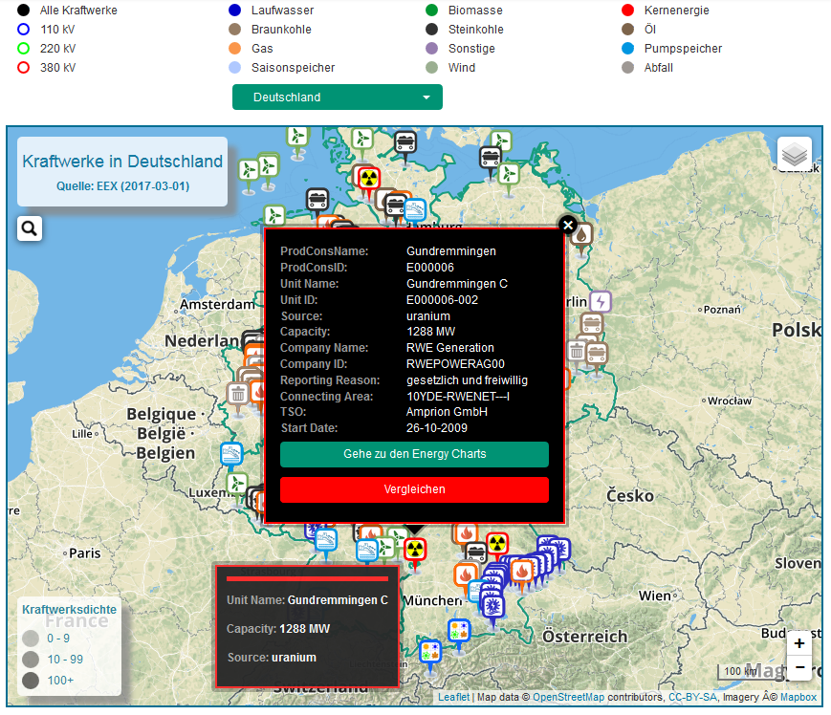
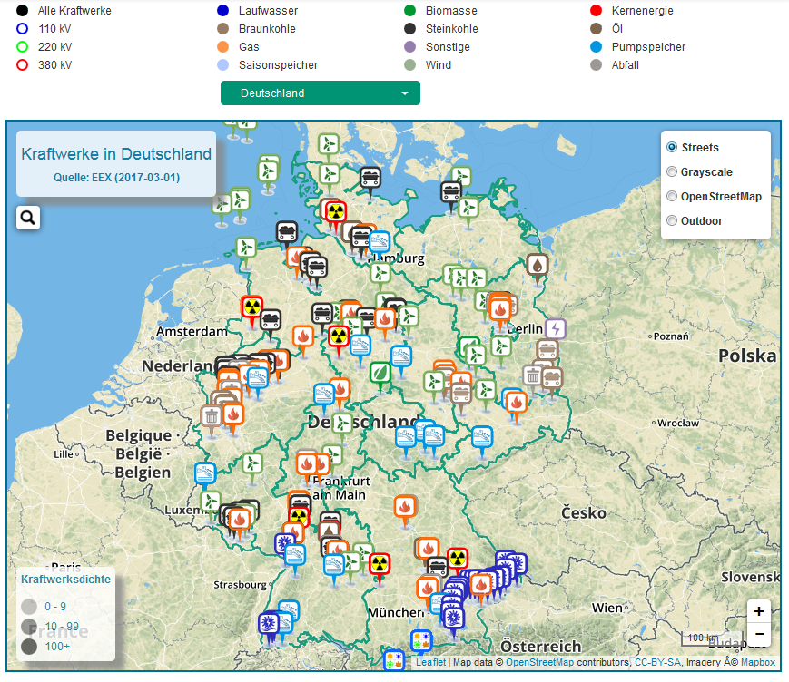
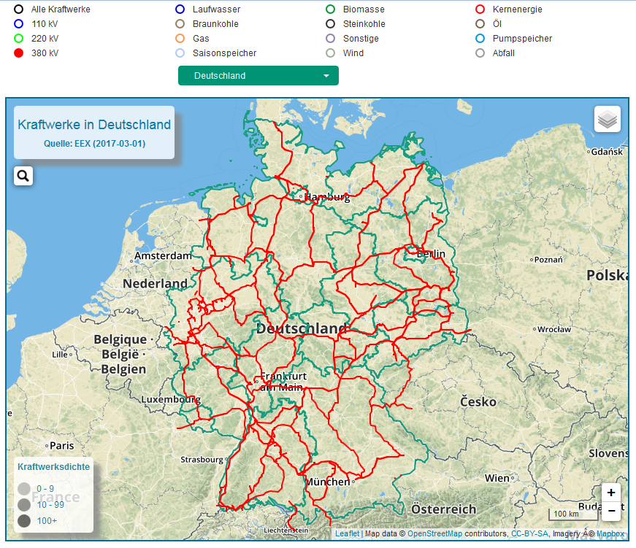
Background contd.
In the frame of this work a new interactive map is developed to visualize the location of power plants and to show their electricity production on Energy Charts
Goals:
To show the location of power plants on the map.
To provide information on power plants.
E.g power source, production capacity, operating company, unit details, date of
To illustrate high voltage power lines (110 kV, 220 kV and 380 kV) of Germany.
Interlink the map and Energy Charts.

Slide 14




Tools
Our online visualization tool is based on JavaScript.
OpenStreetMap (OSM) technology is used for creating the map.
Leaflet – open source JavaScript library is used to make the map interactive.
Mapbox – is used to load different base map layers.

Slide 15

Web applications
The frontend of our interactive map is based on HTML, CSS, JavaScript and Bootstrap.
HTML & CSS – is used to design frontend and to support almost all web browsers.
jQuery – is used to select and manipulate DOM elements, handling events of navigation menus.
Bootstrap – design system is used for styling and for making the page responsive.
Bootstrap

Slide 16
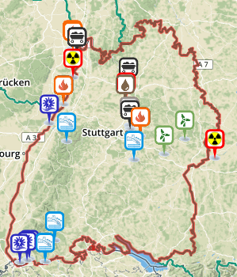
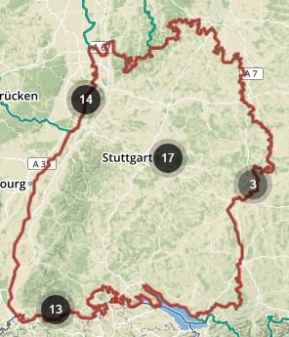
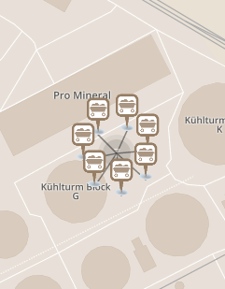
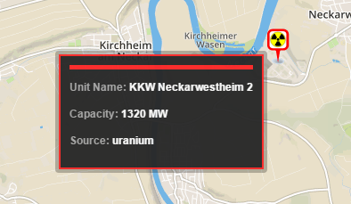
Leaflet libraries & Plugins
Additional plugins used to eliminate the necessity to reprogram the basic operation and functionality.
Leaflet.markercluster – is used to show the density of power plants in a certain region.
Leaflet.label – is used to quickly view the information of a singular power plant inside a tooltip.

Slide 17







File Format & Data Source
Data files that have been used for power plant visualization and their production in the Energy Charts are in the JSON format.
Power data source:
European Energy Exchange AG, Leipzig.
Power plants (capacity >100MW) have to report EEX. (Real time electricity production)
Automated scripts generate JSON files.
Files are stored in the Energy Charts server
for further operation.
Power Plants
Capacity >100MW
json
Energy Charts
File Server
EEX Server
(Data Base)
Notes:
European energy exchange , Germany’s Energy exchange is the leading energy exchange in Central Europe.
EEX operates market platforms for trading in electrical energy, natural gas, CO2 emission allowance for coal.

Slide 18
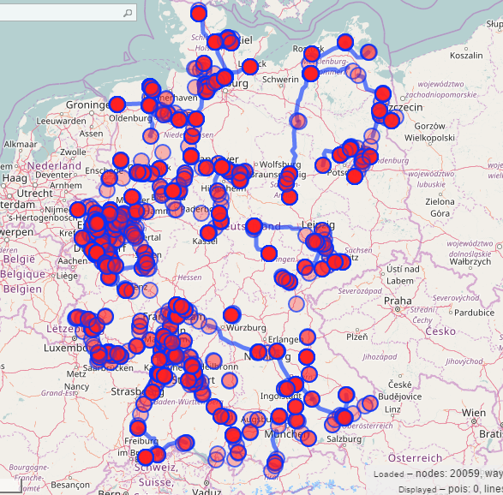
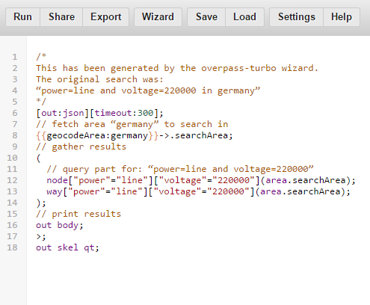
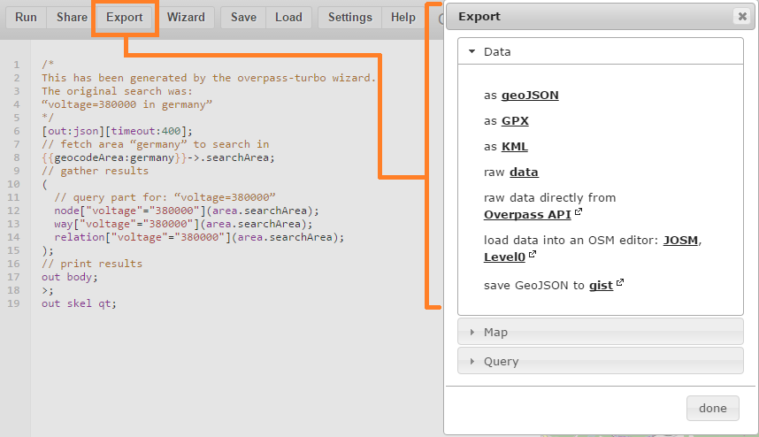
Power line Data Source
Power transmission line data are extracted from the overpass-turbo API. Overpass API acts like a database of OSM.
It also offers search possibilities for viewing power lines on the OSM.
Power line data query:
Running a python script for each power lines.
Key tag: power= line, Voltage= 220 kV
Repeat this process 3 times for 110 kV, 220 kV and 380 kV power lines.
Export the data in GeoJSON format.
GeoJSON files are stored in the FTP server for further operation.

Slide 19
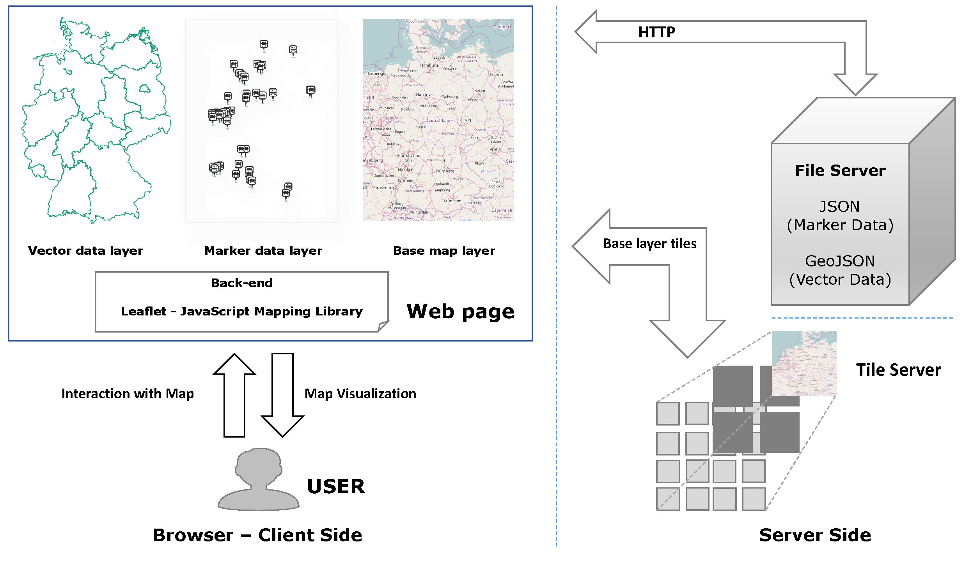
Software System

Slide 20






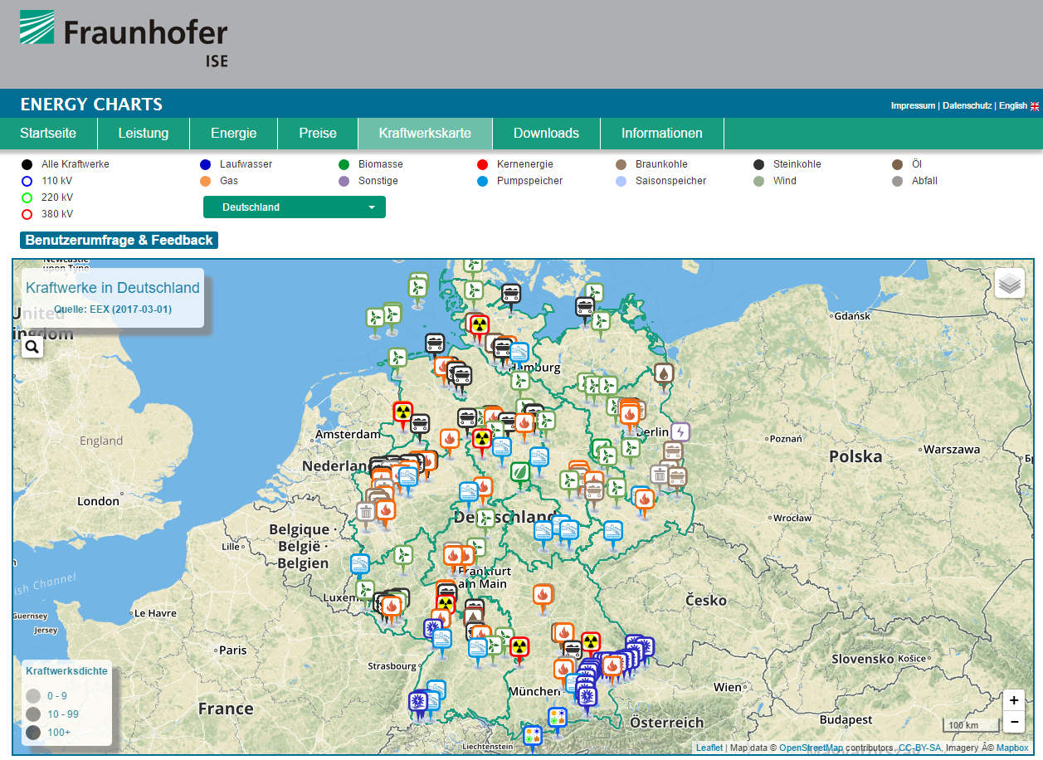
Work Flow
Energy Charts/map
HTTP request
Energy Charts
Web Server
HTML, CSS,
JavaScripts
& JSON Files
Browser
HTTP response
Base map Tiles
Map View
in the
Browser
Mapbox
Map tile server

Slide 21
Work Flow
Energy Charts/map
HTTP request
Energy Charts
Web Server
HTML, CSS,
JavaScripts
& JSON Files
Browser
HTTP response
Base map Tiles
Map View
in the
Browser
Mapbox
Map tile server

Slide 22
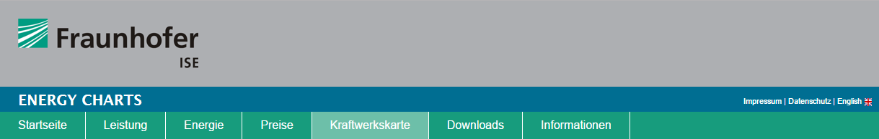
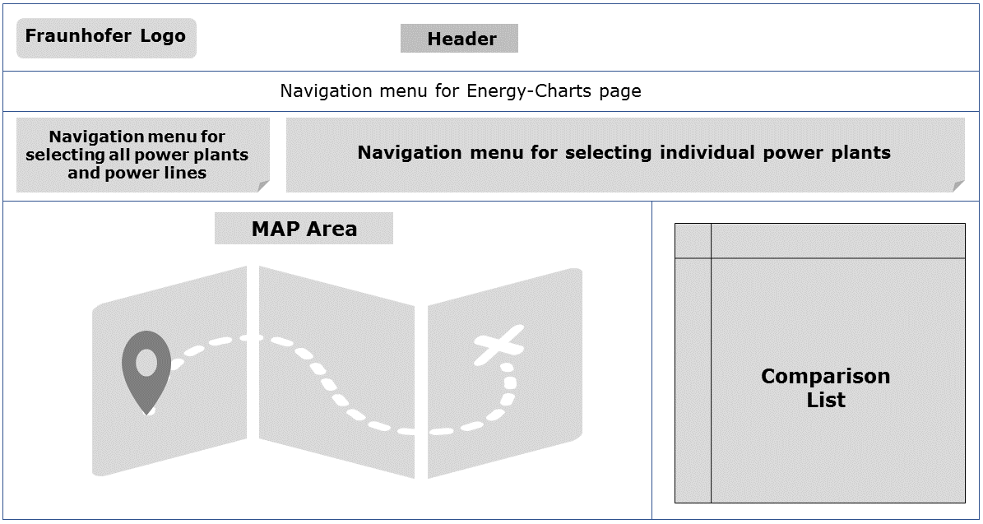
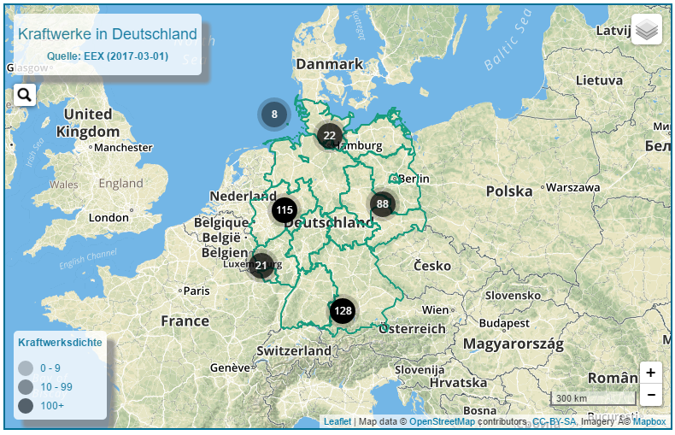
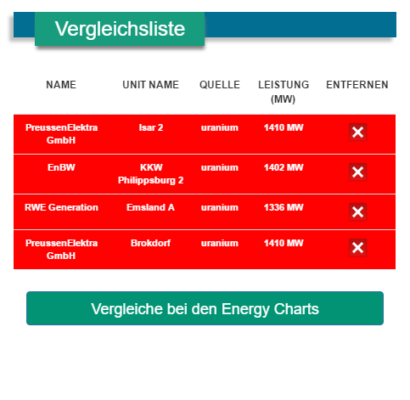
Map
Layout of online visualization tool

Slide 23
Map – Navigation Menu

Slide 24
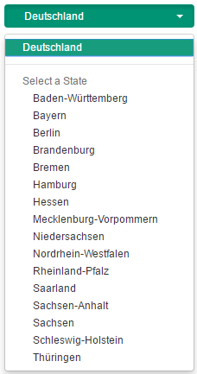

Map – Navigation Menu
Power plant Selection
Power line Selection
German States Selection

Slide 25
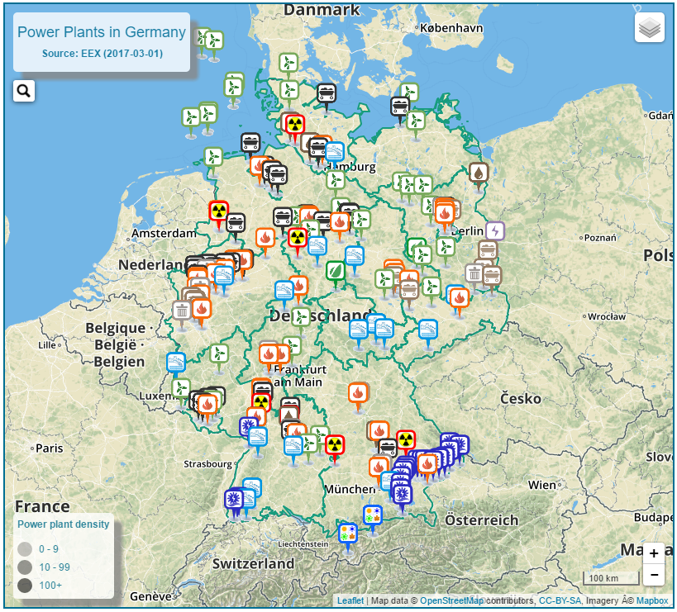
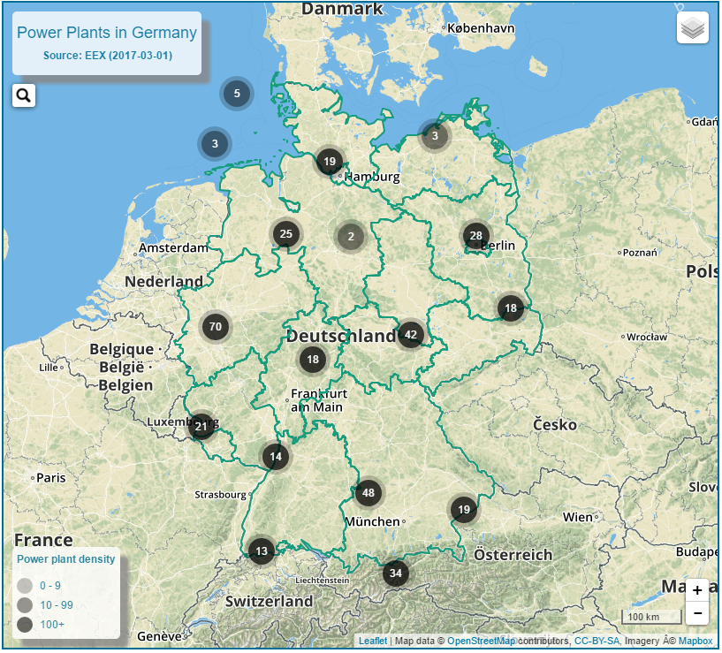
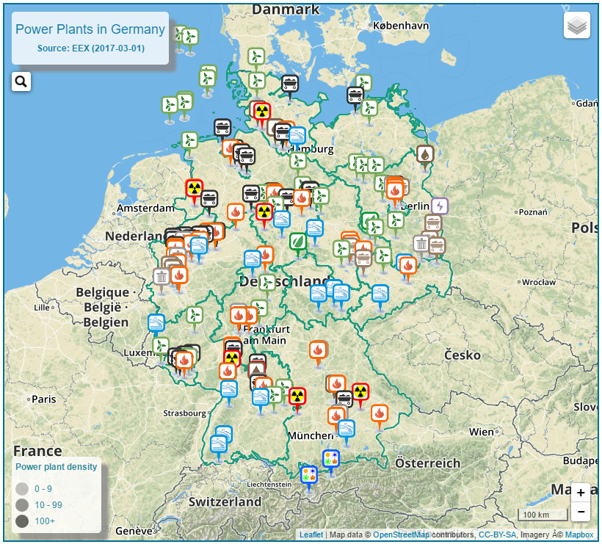
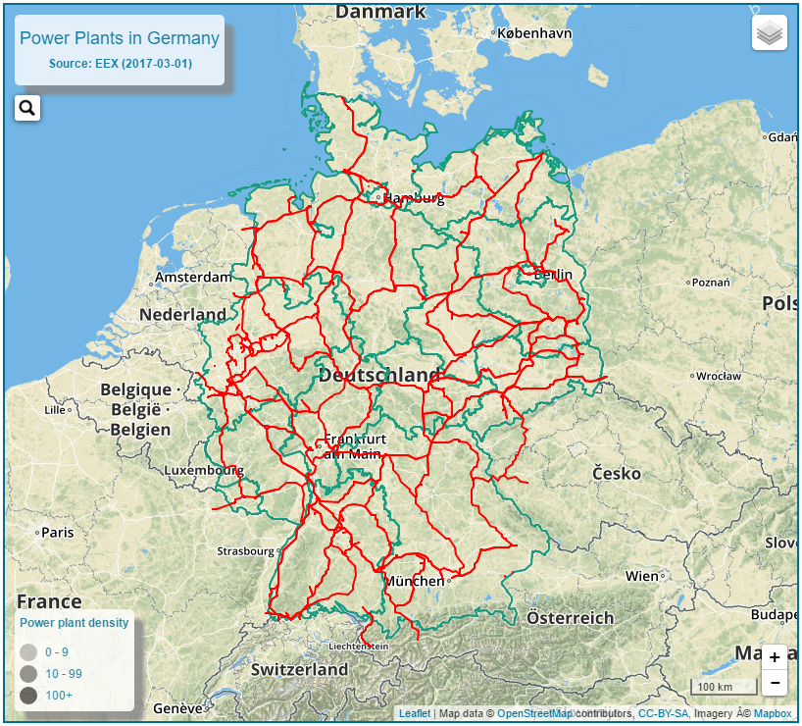
Map – Navigation Menu
Default View
Current View

Slide 26
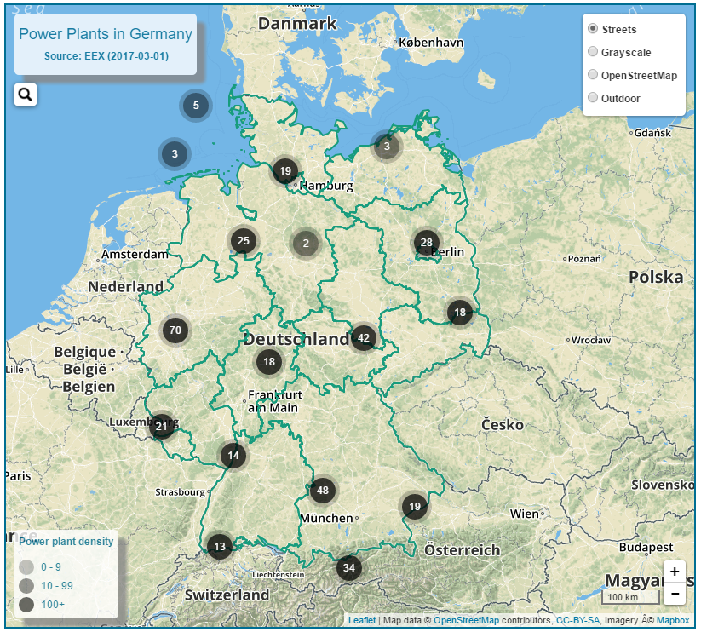
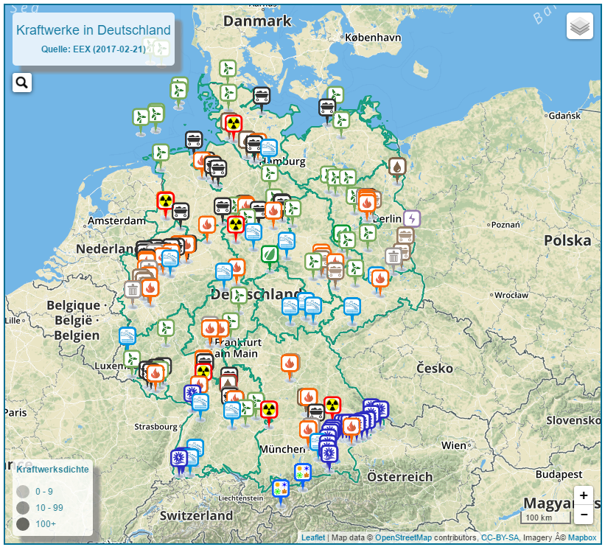
Map - Interface
Map interface includes :
Legends:
Title & Source info
Power Plant density
Controller:
Zoom controller
Base map controller
Marker:
Cluster (Circular marker with number)
Glyph based marker

Slide 27
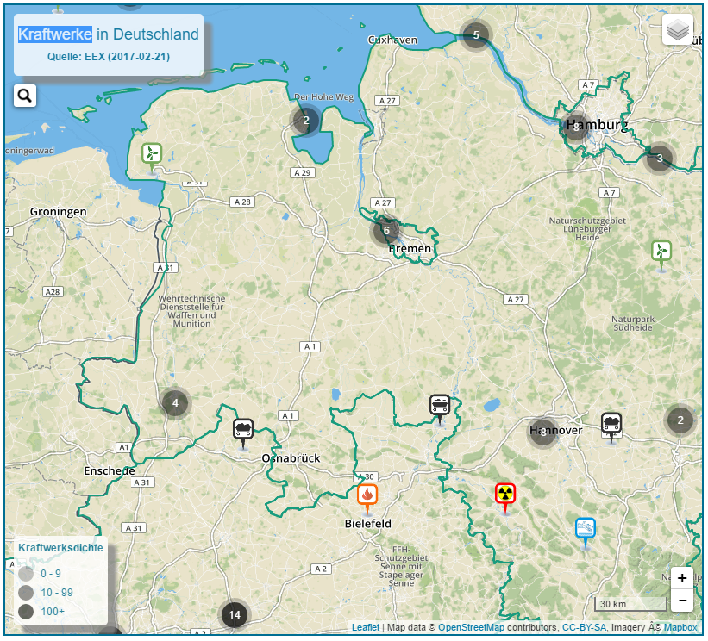
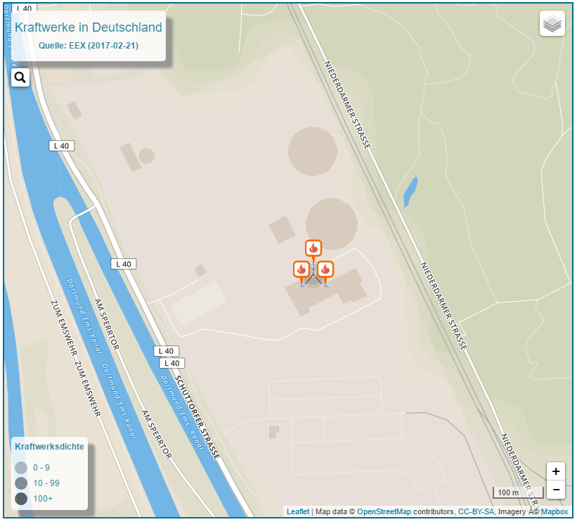
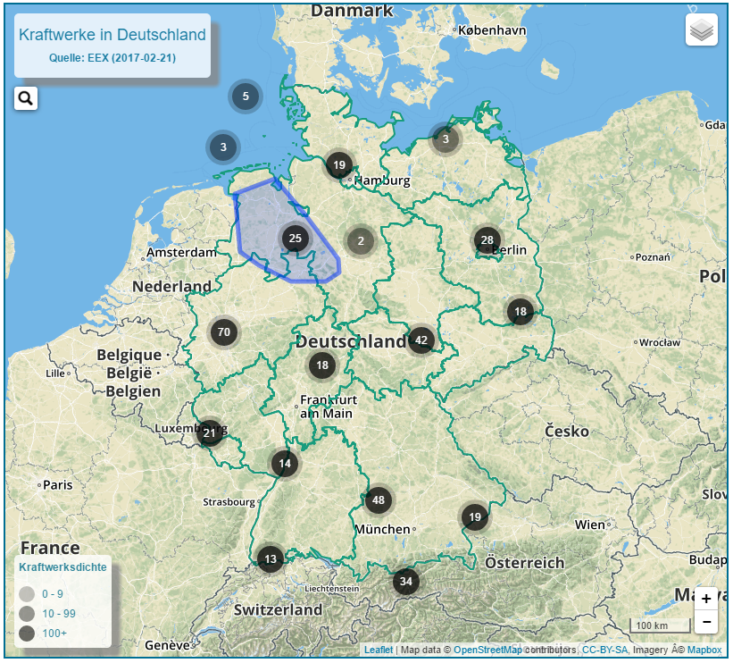

Map - Interaction
Cluster View
Hover over a cluster - shows the area covered by the children of cluster.
OnClick a cluster – fits the covering area on the screen
Spiderfy cluster on existence of multiple power plants in the same area.

Slide 28
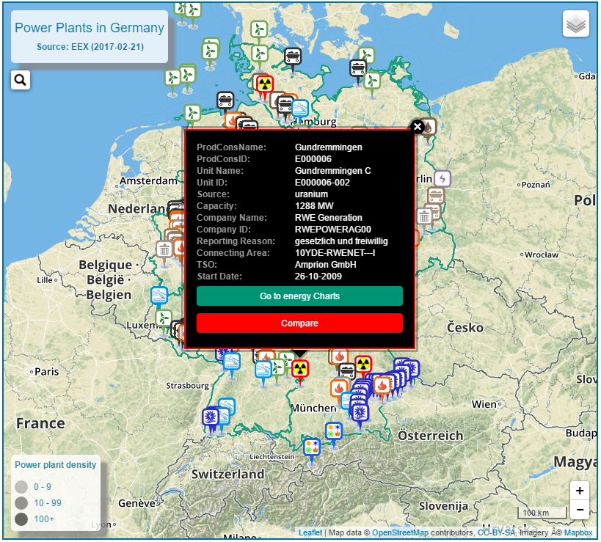
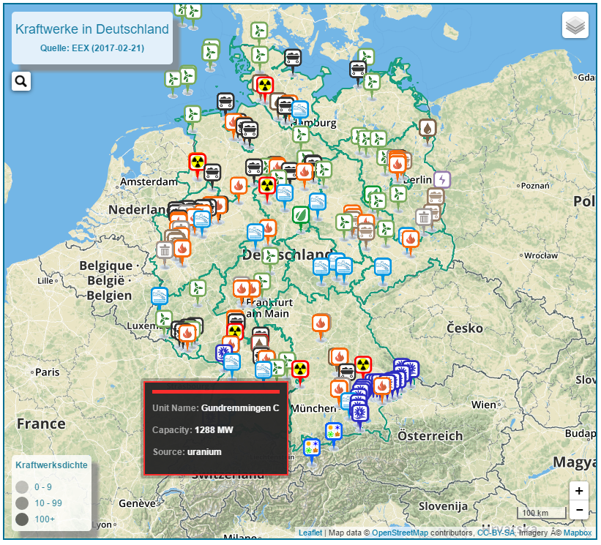
Map - Interaction
Marker View
Hover over a marker – shows unit name, capacity and source inside a label. ( Leaflet.label plugin )
OnClick a marker – shows a popup box.
Popup box – includes information on power plants.
Buttons inside popup box:
Go To Energy Charts
Compare

Slide 29

Map - Interaction
“Go to Energy Charts” button
OnClick “Go to Energy Charts” - redirects page to hourly production charts
Link carries “source” and “unite id” for the selection.
Interlinks the map with hourly production chart.
Go to Charts → Select “Nuclear” → Show Grundm. C

Slide 30
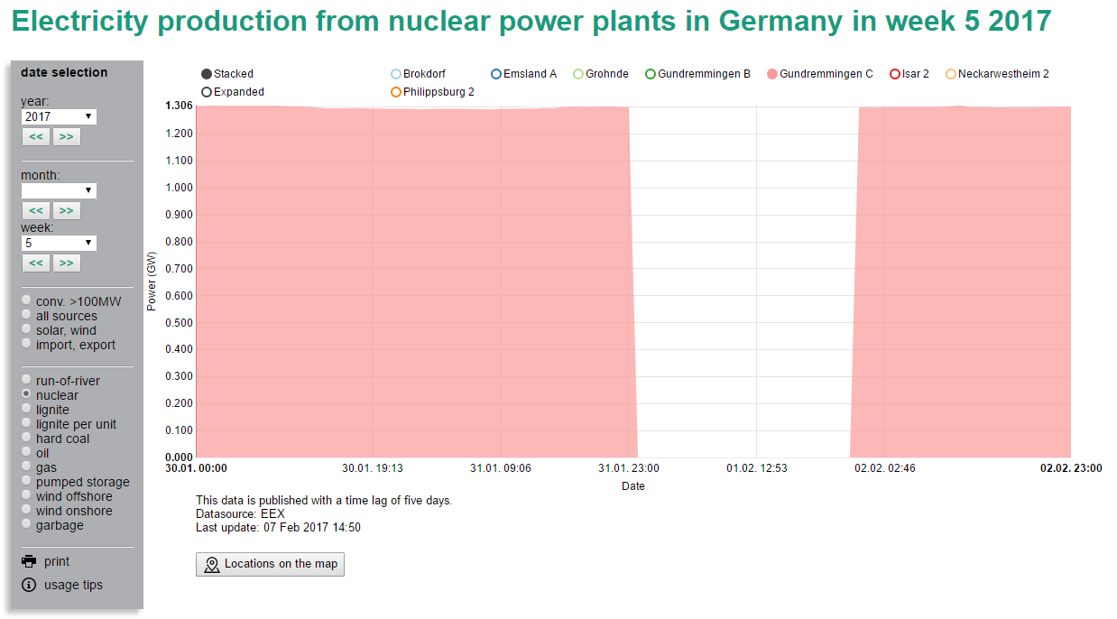
Map - Interaction
Electricity production chart
Go to Charts → Select “Nuclear” → Show Grundm. C

Slide 31
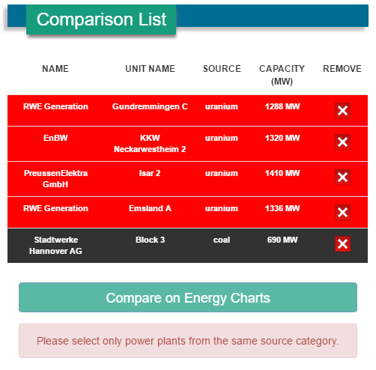
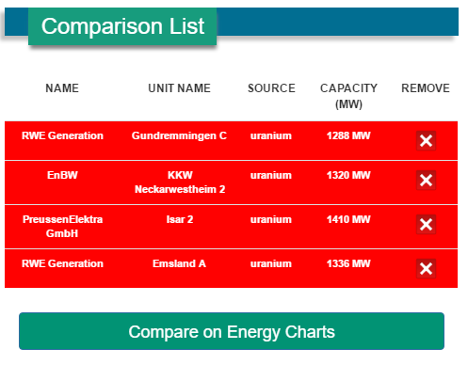
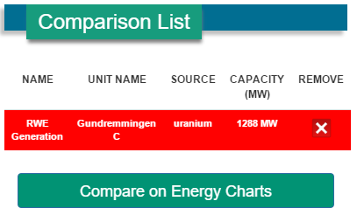
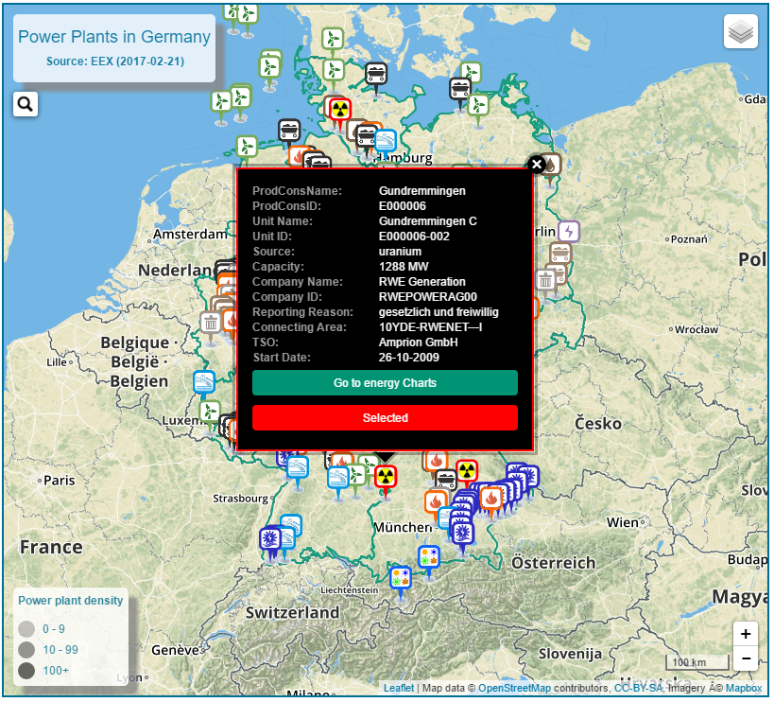
Map - Interaction
“Compare” button
OnClick “Compare” – A comparison list appears next to the map.
Button status - “Selected”
Selected power plant is listed on the comparison table.
More than one power plants can be added.
Note: Same source category
Compare them on Energy Charts – using “Compare on Energy Charts”

Slide 32


Map - Interaction
Compare all on EC → Select “Nuclear” → Show production of listed power plants

Slide 34
Kazi Riaz Ullah
kazi.riaz.ullah@gmail.com
INFOTECH

Slide 35

Kazi Riaz Ullah
kazi.riaz.ullah@gmail.com
Master program INFOTECH

